Slide 1
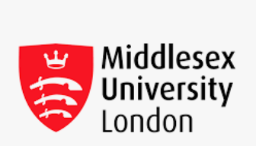
CST1500
Computing Systems Architecture and Operating Systems
Lecture 1 – Data Representation 1

Slide 2
What is Computer Architecture?
The study of the computer hardware
Why study computer architecture?
    To understand what computer really is
    What is inside a computer
    Why a computer is designed
    Understand the assembly language programming
    Optimize programs written in high level languages
    To understand the components that make up the computer and the way they are interconnected
    Be aware of the advancements in computer architecture
    To understand what our programs mean

Slide 3
Outline for Computer Architecture
Data representation
Introduction to digital logic
Combinatorial & sequential logic design
Overview of a computer and CPU
Instruction sets and addressing modes
Machine, Assembly and high level programming
Primary and secondary storage
Control unit and microprogramming
More computer architecture
Input-Output

Slide 4
Overview of Data Representation
What is data? Data - a fact (information)
Bits, bytes, words
Characters
Integers
Binary, octal, hexdecimal notation
Conversions between binary, octal, hex, decimal
Representation of negative numbers
Binary addition and subtraction
Representation of real numbers

Slide 5


How is Data Represented In a Computer?
The digital computer is binary
Everything is stored in one of two states: true, or false
  which can be thought of as 1 and 0
  or a switch which is on or off (voltage, no voltage)
or
An instance of a state is called a bit (binary digit)

Slide 6

How is Data Represented In a Computer?
Values are represented as sequences bits: 1000001
What does this particular sequence mean?
How does the computer know what any particular sequence of bits means?

Slide 7
How is Data Represented in a Computer?
It depends on how you interpret it:
  65 (in decimal)
  ‘A’ (in ASCII)
  Or anything else you want it to mean!
The computer doesn’t know – you know

Slide 8
Computer Memory
The data currently being worked on is (normally) stored in the computer's memory
Memory is just like the switchboard in your home, each switch has a number. They’re all there all the time and each has a state (on or off). You change the state by flipping the switch.
In the computer each data item has:
  an address or location (the switch number)
  a value (the state)
In high level languages we name some of the locations

Slide 9
Bits, Nybbles, Bytes
The smallest unit of storage is the bit (1 or 0)
For convenience bits are grouped together into larger units. A nybble (nibble, or nyble) is 4 consecutive bits. Its just like a box drawn on the switchboard
A byte is 8 consecutive bits (2 nybbles)
For convenience it is bytes that are given addresses in the (modern) computer (bits and nybbles are too small to work with most of the time).

Slide 10






Bits, Nybbles, Bytes
1 bit = 1 switch
1 nybble = 4 switches
1 byte = 8 switches
7 6 5 4 3 2 1 0
0
1
2
3
Computer memory is a switchbox

Slide 11
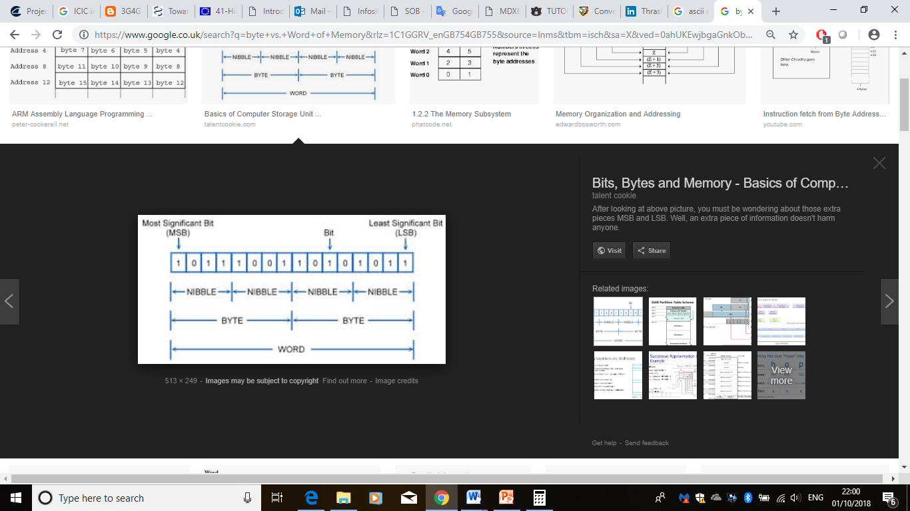
A Word of Memory
The word is the number of bits the CPU uses internally. It varies from manufacturer to manufacturer and from CPU to CPU. These days it is usually 32 or 64 bits.
Bits
– 8
– 16
– 18
– 32
– 36
– 64
Computer
Atari 800, Commodore 64, Apple ][ IBM PC XT, Macintosh, DEC VAX DEC PDP 15
IBM 370, early Android and iOS phones Honeywell, UNIVAC
Cray-1, iMac, PC, and modern smartphones
Notes:
Word is the number of registers

Slide 12
Characters
A character (char ch;) is a written symbol. They are (for English) represented as a single byte. In other languages they can be represented as 2 bytes (or more).
Characters include:
  UPPER CASE LETTERS
  lower case letters
  Single digits
  Special characters
A C X . . .
b g k . . .
3 1 9 . . .
! < = . . .
We can join these together in sequences to make (human readable) numbers and words

Slide 13
ASCII Character Code
How does the computer know that ch is an 'A' and not 'a' or '3' or anything else? It doesn’t!
1.The computer uses ch as an integer index into a pre-existing table, e.g.
0001000000101000010001001000001010000010111111101000001010000010
Or, for clarity, an array of bytes like this:
unsigned char bits[65] = {16, 40, 68, 130, 130, 254, 130, 130}
2. The computer screen is made up of thousands of little dots called pixels. They are in a rectangular grid, like a table.

Slide 14
ASCII Character Code
0001000000101000010001001000001010000010111111101000001010000010
00010000 00101000 01000100 10000010 10000010 11111110 10000010 10000010
When the computer is asked to “print” a character it turns on and off some of those pixels. We then interpret the drawing.
We have imposed meaning: We have given it a value

Slide 15
ASCII Character Code
There are several standard tables that describe what to draw, and fonts that describe how to draw them.
ASCII (the American Standard Code for Information Interchange) describes what should be drawn for Roman (English-like) alphabets.
– For example:
A | 1000001 | (65)
a | 1100001 | (97)
9 | 0111001 | (57)
But there are only a few letters, numbers, and punctuation marks. The remanning ASCII codes are non-printing and have other meaning (such as line feed, form feed, tab, etc.).

Slide 16
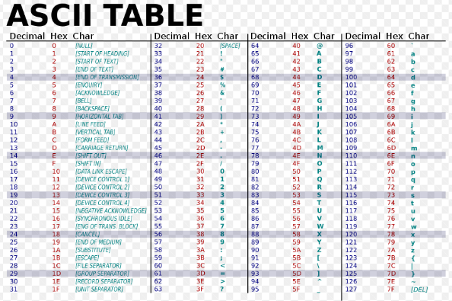
ASCII Character Code (cont.)

Slide 17
ASCII Character Code (cont)
ASCII characters are represented by a 7-bit code.
E.g. letter ‘A’ = 65 = 1000001
There are, therefore, 128 (2⁷) possible characters. They are usually stored in memory as a byte with the 8th bit set to 0.
For sorting purposes characters are compared on their numeric value (called the collating sequence). ‘A’ is before ‘Z’ but ‘a’ is after ‘Z’!

Slide 18
Other Character Codes
EBCDIC
Extended Binary Coded Decimal Interchange Code. Used with large (old) IBM computers.
BAUDOT
An old paper tape code
BCD
Binary coded decimal. 6-bits + check bit.
Used on some magnetic tapes.
80 column
12-bit code used on punch-cards.

Slide 19
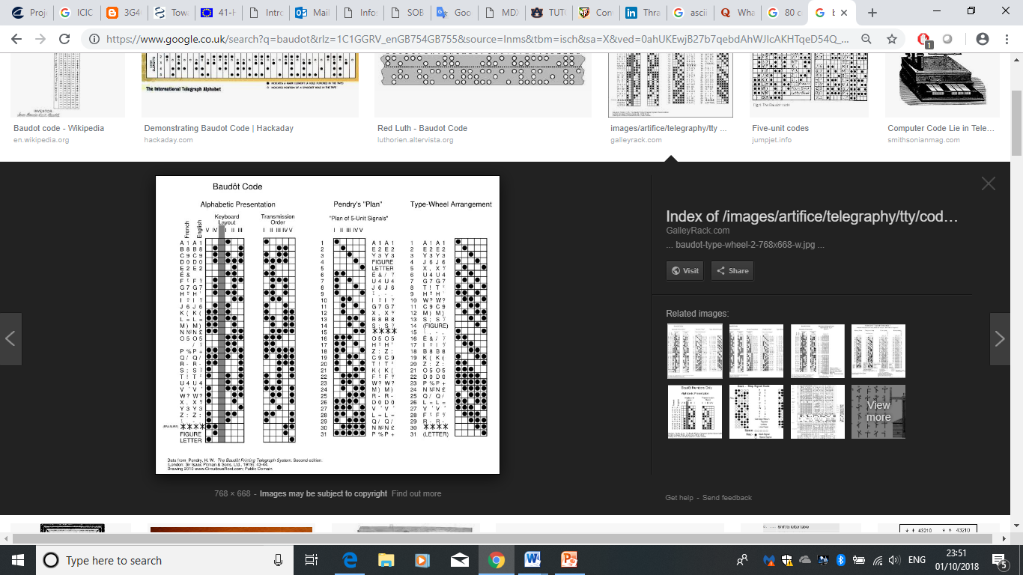
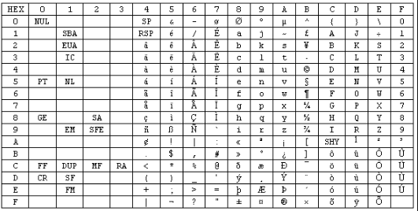
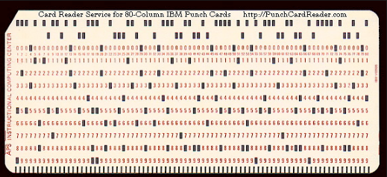
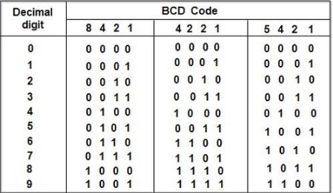
EBCDIC
BAUDOT
80 column
BCD

Slide 20
Unicode
What about all the non-Roman characters?
  Greek, Arabic, Chinese, Hebrew, Japanese, Thai, etc.
What about characters that represent ideas, concepts, phrases?
  Emoji, etc.
Unicode
  Developed by The Unicode Consortium
  Coordinated with ISO/IEC 10646
Originally a 16-bit code (compatible with ASCII)
  Mapped 16-bit values into glyphs (characters)
  65,536 characters were possible
Now a 21-bit code with 136,690 characters from 139 scripts
  Some (many) are reserved

Slide 21
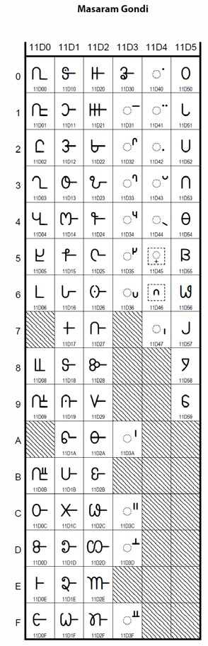
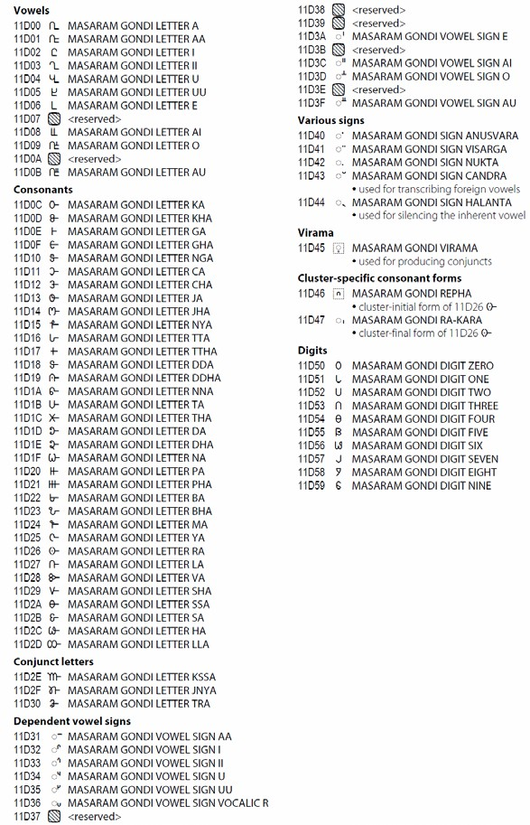
Unicode (cont.)
http://www.unicode.org/charts/PDF/U11D00.pdf

Slide 22
Character Strings
Think of this….
– How are character strings (e.g. “hello world”) stored in a computer?

Slide 23
Summary
Your machine speaks different language than yours. It is zeros and ones (Binary)
The OS works as an interface and allows you to interact with your computer.
The OS with the Hardware form a complete system and determine what your computer can do
Without the OS, your machine is useless
ASCII is used to represent both textual data (letters, numbers, and punctuation marks) and noninput-device commands (control characters).

